Slide 1
Project Proposal
Odnan Galvan
ENGI 301

Slide 2
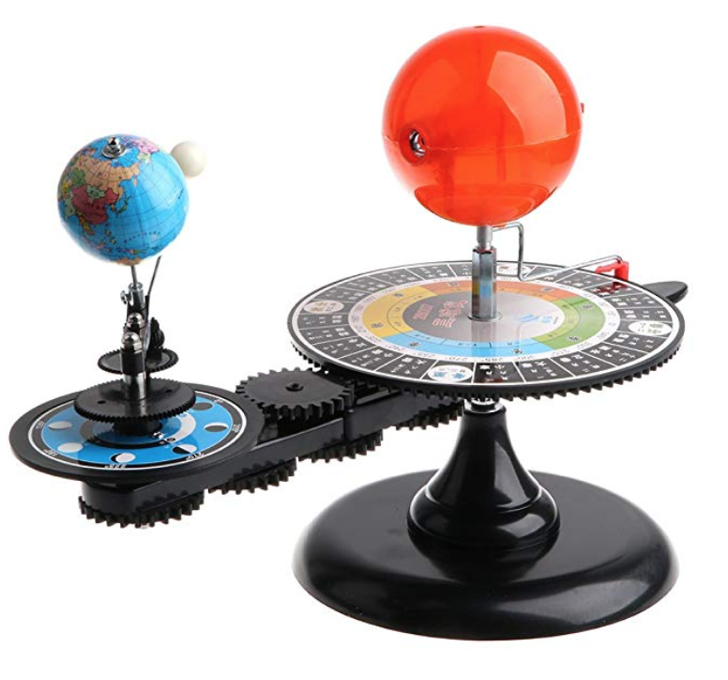
Proposed Project
Desktop Decoration
Consists of Globular Earth and Sun.
The Sun is an LED, the Earth begins to spin at about 6RPM (but can be manually adjusted) when LED is turned on by use of a light sensor.
An LCD screen will be used to display the current time. Earth will be able to rotate to time input to LCD
Even cooler than this (not really)

Slide 3



Projects I’m Building On/Using
Mini A/C rotor
https://beagleboard.org/p/nikhita-gangla2/mini-ac-unit-with-pocketbeagle-mikro-click-boards-19311b
Drone Rotors
https://beagleboard.org/p/walkergrimes5/pocketbeagle-drone-part-1-d80868

Slide 4
How Will The Existing Projects Be Used
Project borrows from each of the previous parts to help in the making on my own in the following way:
Mini A/C rotor & Drone Rotos:
Intend to modify some of the code used to control the rotation of the fan/motor. I also hope to be able to use the temperature sensor code as a basis for writing a something similar for a light sensor.

Slide 5
Libraries Needed
Stepper Motor Library:
https://github.com/arduino-libraries/Stepper
Light Sensor Library
https://github.com/claws/BH1750

Slide 6
System Block Diagram
Cape Header (P1)
OSD335X-SM SiP
Contains:
AM3358
TPS65217C
TL5209
EEPROM
Cape P1 Signals
User I/O:
4 LEDs
PWR
GPIO
JTAG
Pads
JTAG
5 Volts
μUSB Host
Connector
USB0
MMC0
μSD Card
Connector
Cape P2 Signals
Cape Header (P2)

Slide 7
System Block Diagram
OSD335X-SM SiP
Pocket Beagle
Super Bright LED
GPIO
Light Sensor
GPIO
Stepper Motor
PWM1_A
5 Volts
μUSB Host
Connector
USB0
Adafruit 4 Digit LCD
12C1_SCL
12C1_SDA

Slide 8
Power Block Diagram
5V Power Micro USB
OSD335X-SM SiP
Pocket Beagle
VIN_SYS
3.3V
Super Bright LED
3.3VOUT_SYS
Light Sensor
SYS_VOUT
3.3V
Stepper Motor
VOUT_SYS
μUSB Host
Connector
USB0
3.3V
Adafruit 4 Digit LCD
3.3VOUT_SYS

Slide 9
Parts To Build
Component | Need to Buy | Cost
Light sensor: GA1A12S202 Log-scale Analog Light Sensor* Or: GY-30 Or: 1528-2141-ND | 1 or 2 | $3.95 $0.87 $0.95
Motor: TM 6SCM1 Or: NEMA-17 , NEMA-17 1.8 Or: GA12-N20 Or: FeeTech FS5103R* | 1 | $4.25 $12.99, $19 $7.61 $11.95
Yellow LED: Should be at OEDK or Super Bright LED | 1 to 3 | $4.95
Globe: 4” Diameter Styrofoam Balls Or: Maybe I can 3D print it. | 1 | $8.52
Map to Wrap Around Globe: Can be Printed | 1 | $0
Total Cost | $21.67

